Slide 1


Simulating Transport Equation
Retegan Mihai Gheorghe
Oanta Robert-Christian
Varvari Dennis-Davi
Rus George-Ioan
Moldovan Cristiana-Andreea

Slide 2
Waves
A wave is defined as an identifiable signal or disturbance in a medium that is propagated in time, carrying energy with it.
A few familiar examples are electromagnetic waves, waves on the surface of water, sound waves, and stress waves in solids, as occur in earthquakes.

Slide 3
Shock wave
A shock wave is strong pressure wave in any elastic medium such as air, water, or a solid substance, produced by supersonic aircraft, explosions, lightning, or other phenomena that create violent changes in pressure

Slide 4
Our Python implementation
We implemented a python program to solve the first order 1-D wave equation (transport equation/advection equation) using the 4th order Runge–Kutta (RK4) and explicit Euler method with 2nd order spatial discretization and periodic boundary conditions for spatial discretization

Slide 5

About Euler method
In mathematics and computational science, the Euler method (also called forward Euler method) is a first-order numerical procedure for solving ordinary differential equations (ODEs) with a given initial value.
Consider a differential equation dy/dx = f(x, y) with initialcondition y(x0)=y0
then successive approximation of this equation can be given by:

Slide 6

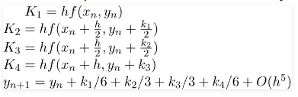
About Runge–Kutta (RK4)
The 4th order Runge–Kutta works in the same fashion as Euler but in our experience and test case we found out it gives more accurate results
Below is the formula used to compute next value yn+1 from previous value yn. The value of n are 0, 1, 2, 3, ….(x – x0)/h. Here h is step height and xn+1 = x0 + h

Slide 7
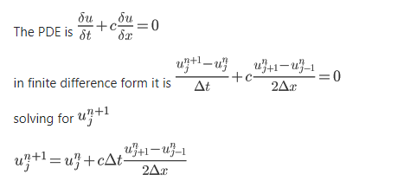
Using the finite difference scheme
But we actually need to solve a partial differential equation (PDEs), so by using the finite difference scheme, we are basically converting our PDE to a system of ODE, which can be then solved using the above numerical methods ( RK4 and Euler )

Slide 8
Now we will show you some examples of our own implementation

Slide 9
Thank you for your time!
Retegan Mihai Gheorghe
Oanta Robert-Christian
Varvari Dennis-Davi
Rus George-Ioan
Moldovan Cristiana-Andreea

